Slide 1
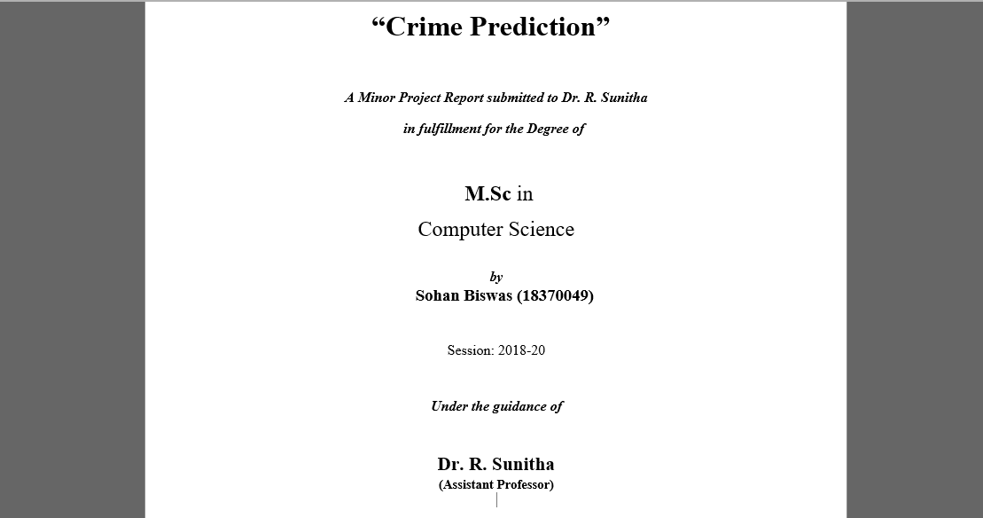

Slide 2
Pondicherry university
Project on: Crime Prediction on San Francisco dataset from 2003-2018;
Under the guidance of: Dr. R Sunitha.
By
Name: Sohan Biswas
Registration number: 18370049
Year: 4th semester, 2020

Slide 3
Abstract
The task at had is to find probable crime density or rate, hence crime prediction and to find probable location for the next crime from the given dataset.

Slide 4
Objective
The dataset used here is “San Francisco Crime Data 2003-2018”
Arrange them to my needs, eliminate null values.
Use the algorithms and then try to predict the location for next possible location for a crime.
Algorithms used:
KNN (for classification of crime and its better understanding)
Decision Tree Classifier (for classification of crime and its better understanding)
Random Tree Classifier (for classification of crime and its better understanding)
LSTM (for prediction)
FACEBOOK PROPHET (for prediction)

Slide 5
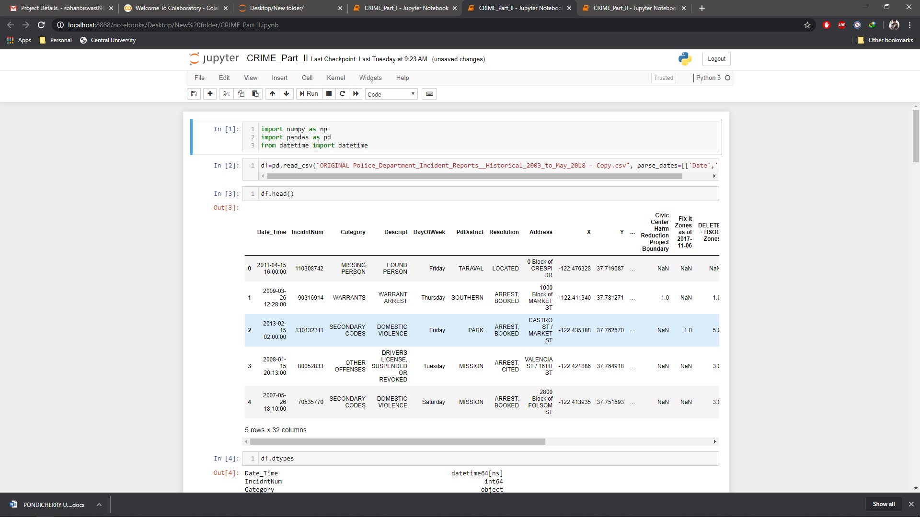
Dataset overview

Slide 6
Dataset pre-processing tasks
Dataset has (2215024, 32) rows and columns based on san Francisco city and its crime details provided in their official page timed from 2003-2018.
Among which many are necessary and others not so much
Pre-processing of this data is necessary for our work so we needed to modify them to our needs
This was not arranged in chronological order too, we needed that to be
Null values had to be removed, if encountered
Other tasks like arranging them to suit my needs

Slide 7
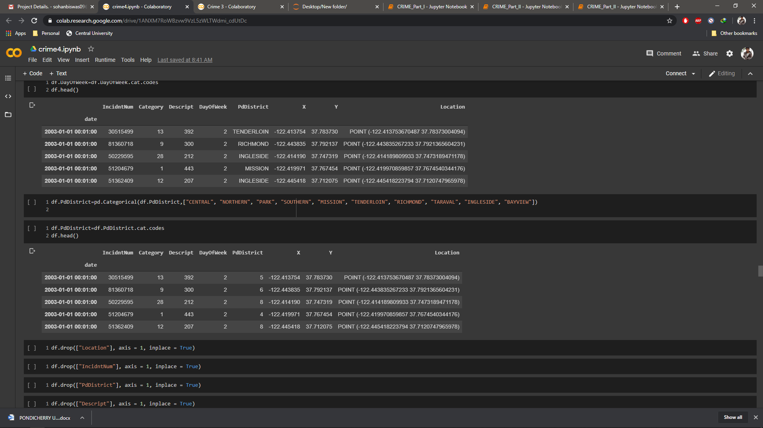
Processed Dataset overview
So as we can see this is now:
arranged in chronological order
Null values removed
Category, descript and other such categories are labelled properly for our use
Unnecessary columns have been dropped for our use

Slide 8
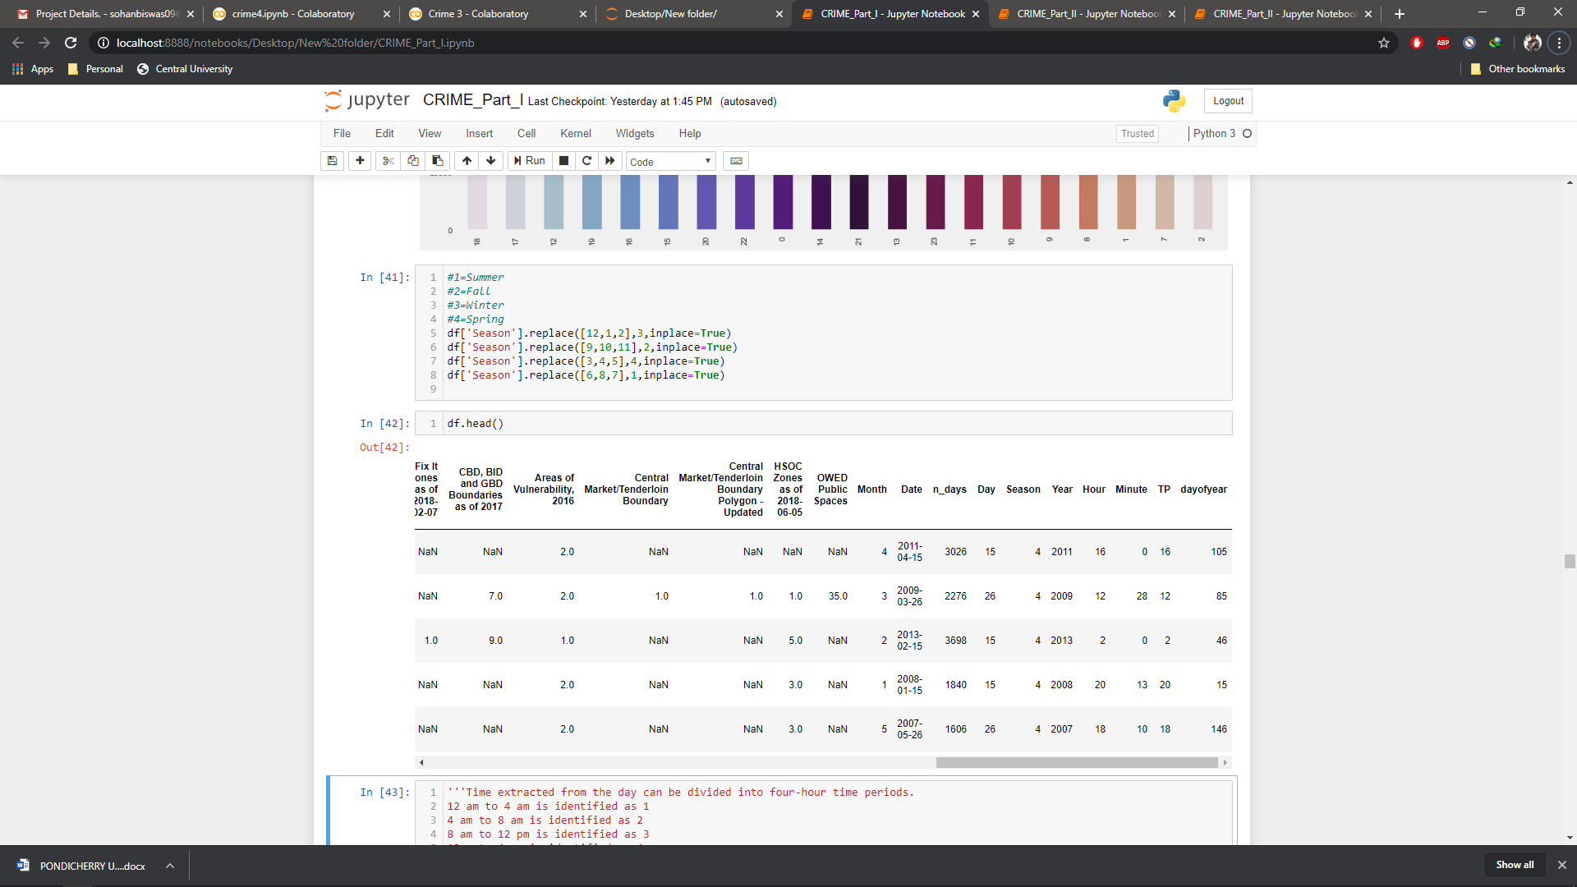
Other tweaks made
Now, these tweaks are made for our work ease. Let me point them out:
We added month, n_days(number of days), day, season, year, hour,
minute, tp(time periods), day of the year and labelled them accordingly to
our dataset.

Slide 9
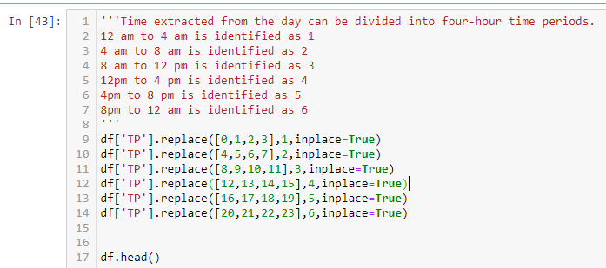
Processed Dataset overview
Now these were added for arranging them accordingly:
Seasons as in summer, fall, winter, spring got from months and labelled accordingly
Tp (time periods) as shown below and labelled accordingly

Slide 10
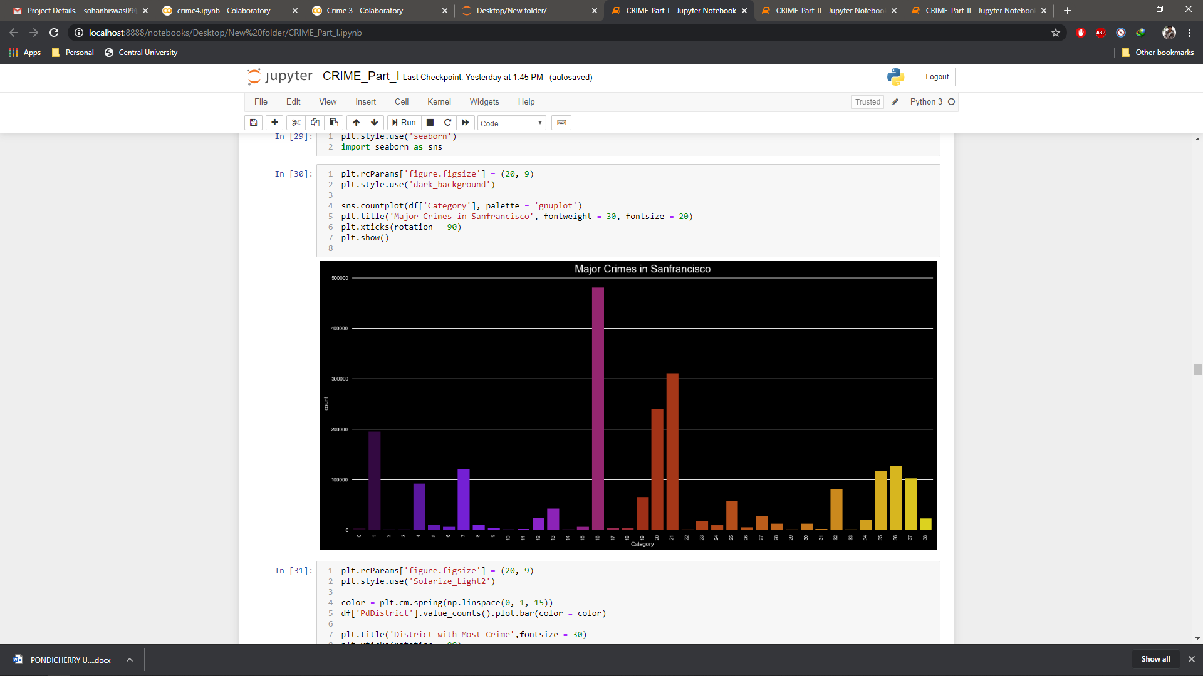
Processed Dataset overview
Major crimes in the city (category vs count)

Slide 11
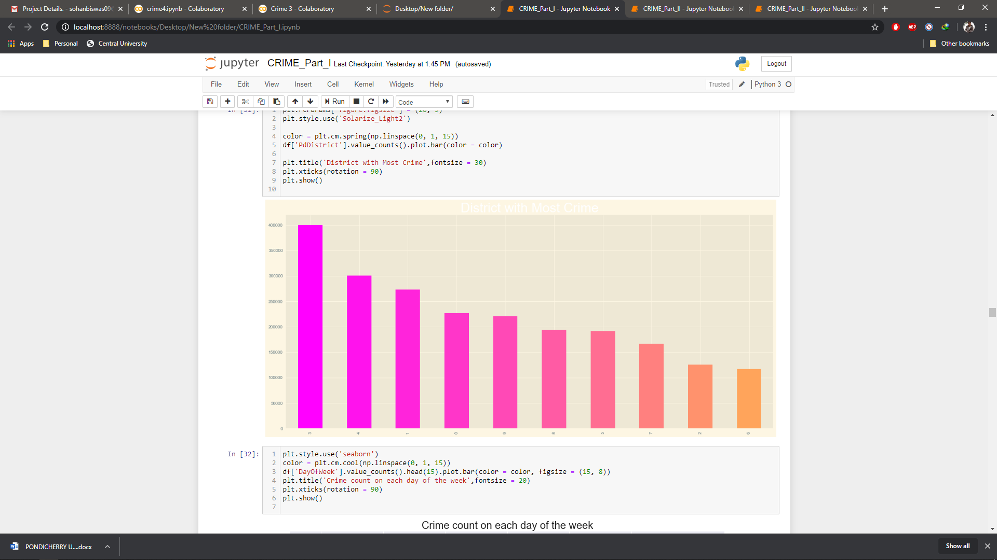
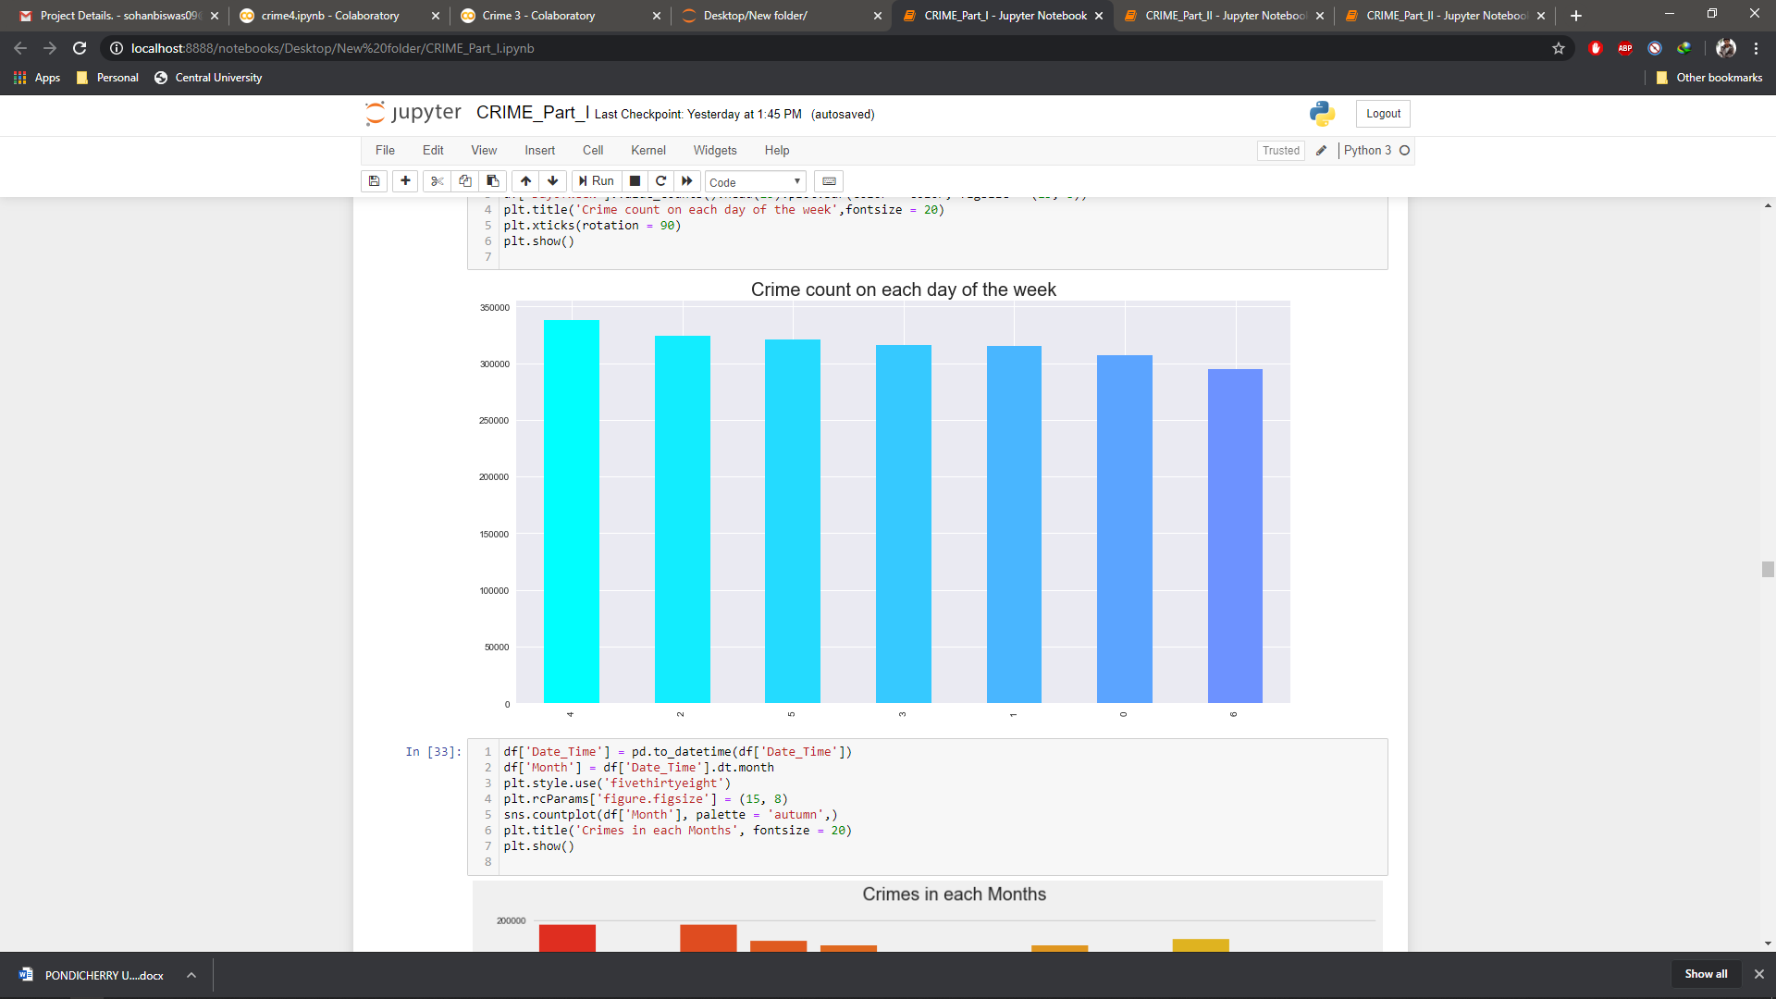
Processed Dataset overview
Major crimes in the city
(districts of the city vs count) (week days vs count)

Slide 12
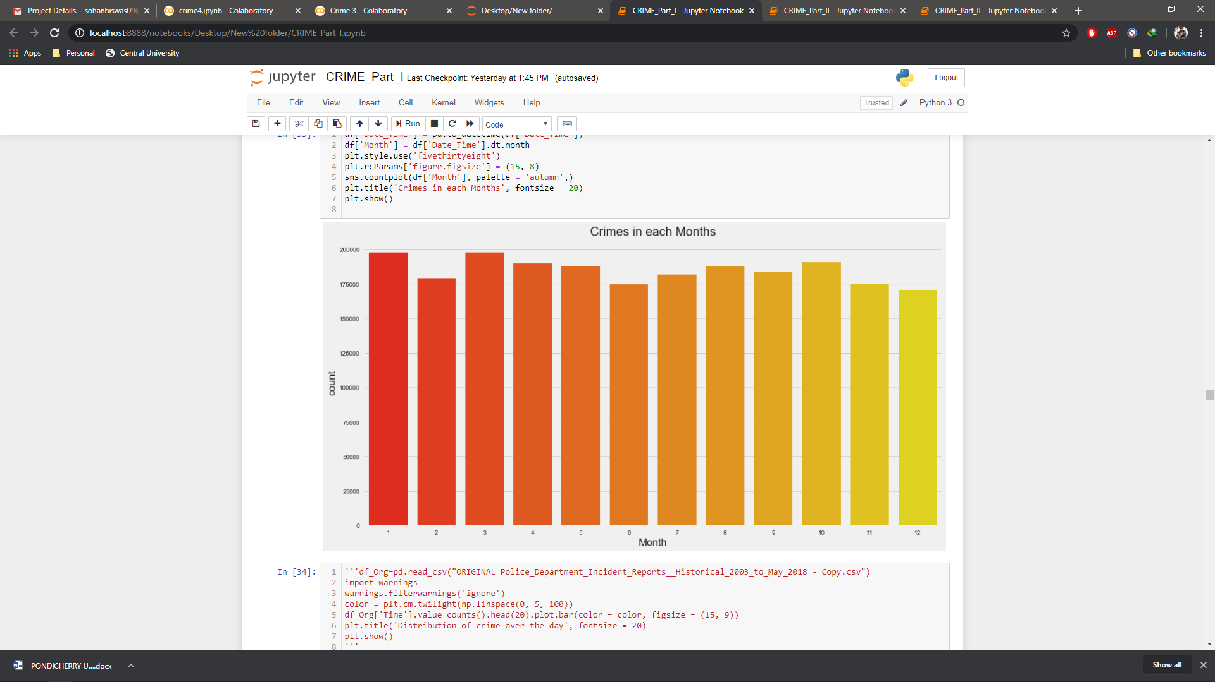
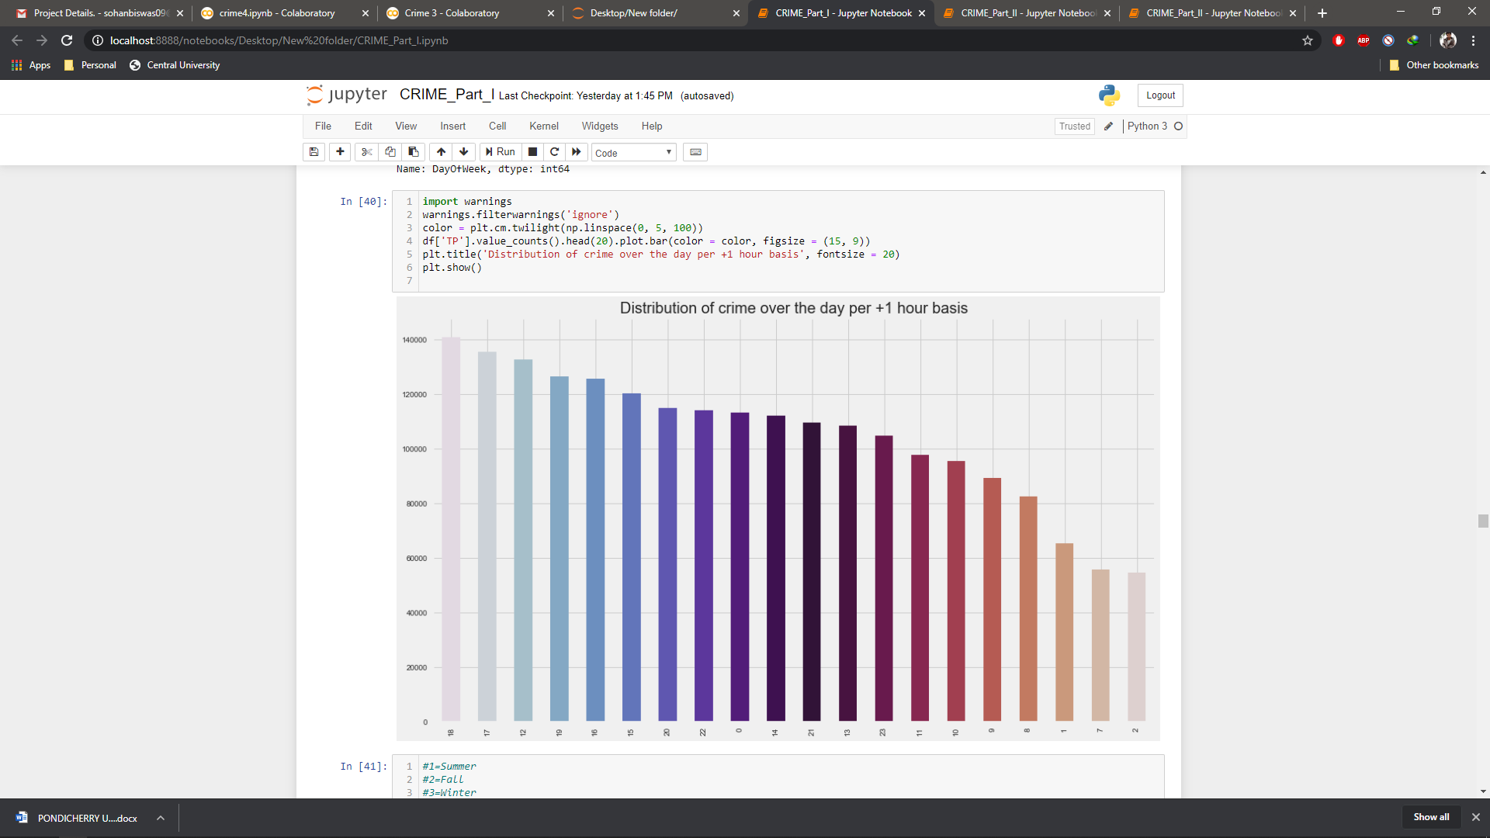
Processed Dataset overview
Major crimes in the city
(month of the year vs count) (+1 basis vs count)

Slide 13
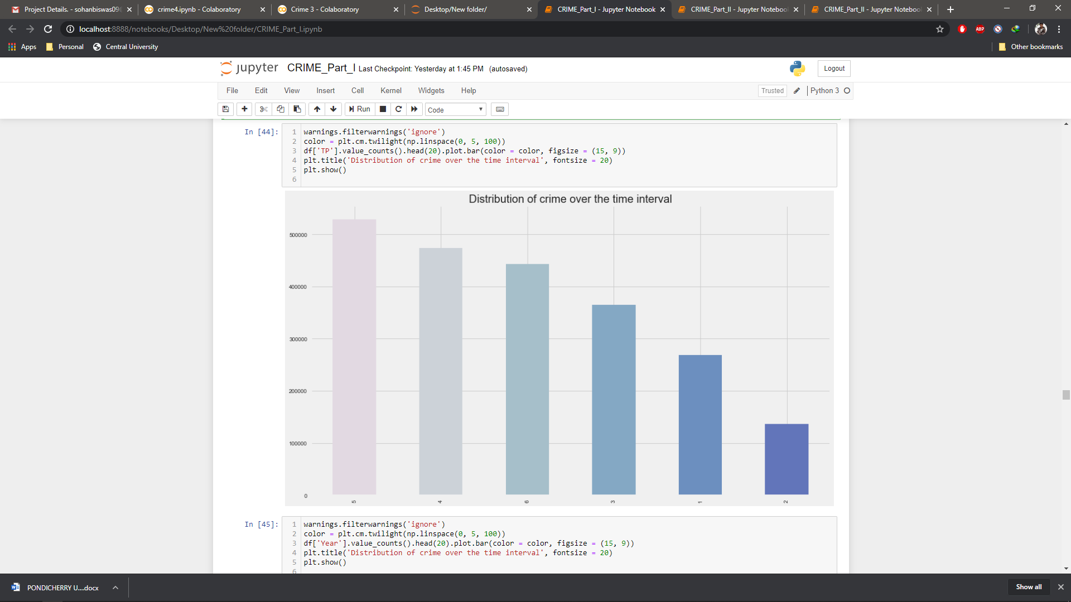
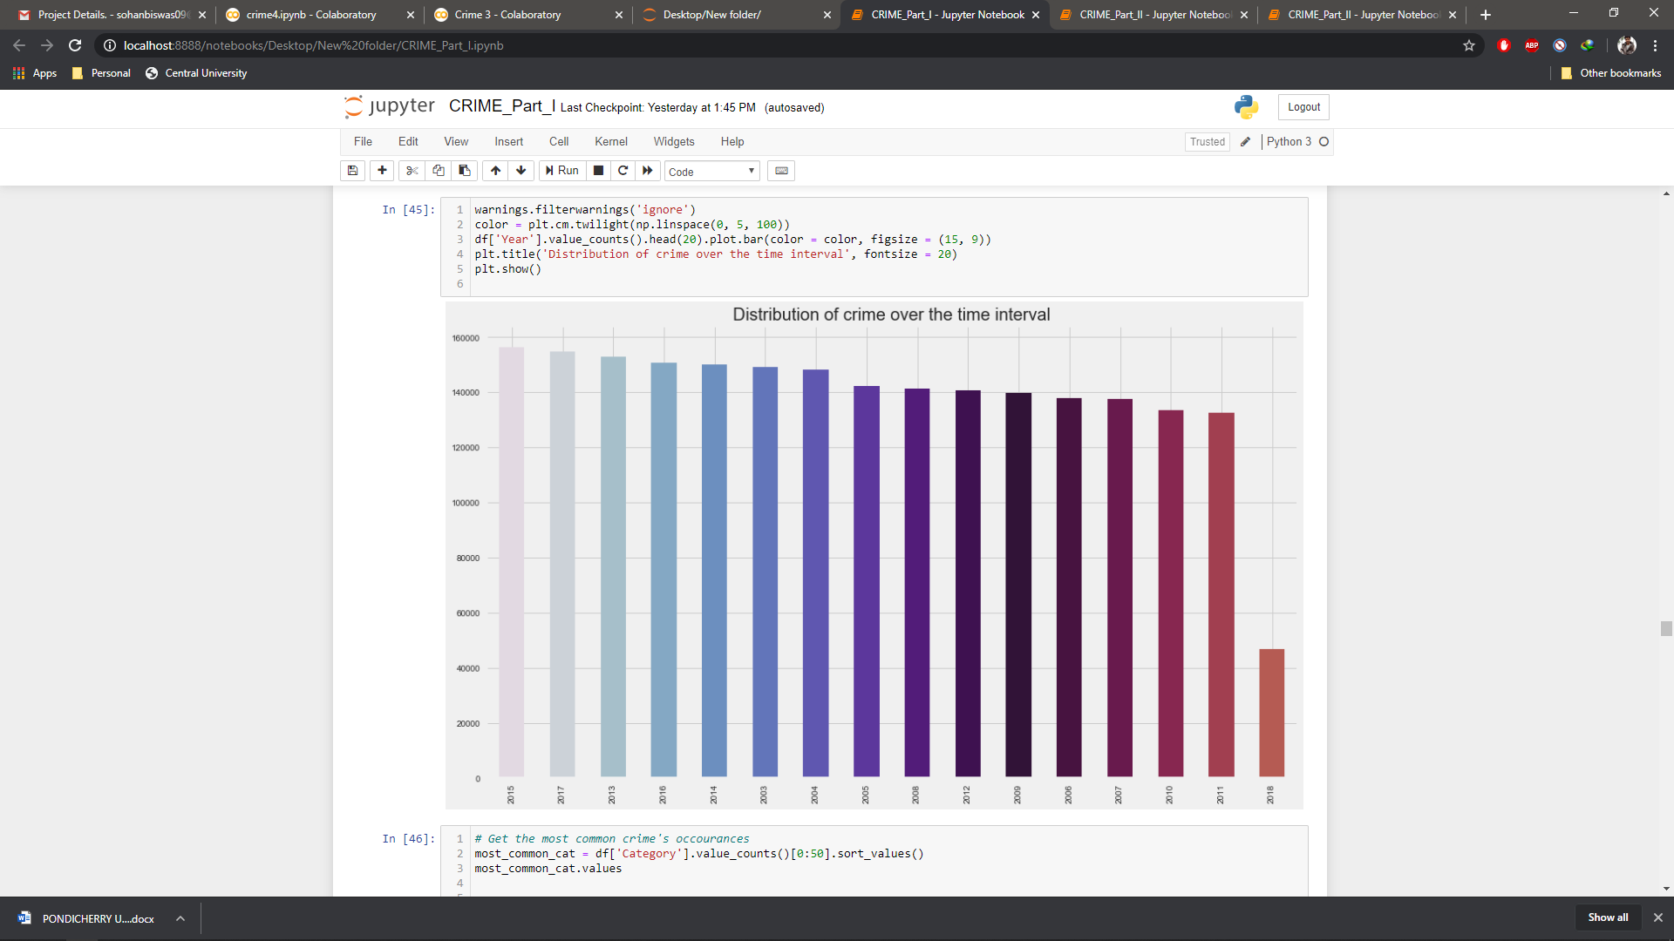
Processed Dataset overview
Major crimes in the city
(Time interval vs count) (year vs count)*
The count may seem very low in 2018 but that’s not the case here, cause the dataset had its data up to may, 2018.

Slide 14
Further speculations of the dataset
Now from all these above we can understand something, that these reported crimes are related in a seasonal format, and follows some pattern.
Like time, season, months etc.
Others seem mostly area based like some districts have more crime rate than others
Others focus mainly on a certain category of crime reported in a greater amount than others
Another shocking recovery was many of the perpetrator of these crimes were not captured, thus remained unsolved.

Slide 15
The objective of our work is to:
Predicting crime before it takes place
Understanding crime pattern
Classify crime based on location
Analysis of crime in SF
Predicting hotspots of crime

Slide 16
Algorithms planned for executions:
After the preprocessing described in the previous sections, we had three different classifications problems to solve, which we proceeded to attack with an assortment of classification algorithms. The following are the algorithms which we are using:
KNN (K- Nearest neighbors) for classification
Random Forests for classification
Decision Tree for classification
LSTM for prediction
Prophet by Facebook for prediction

Slide 17
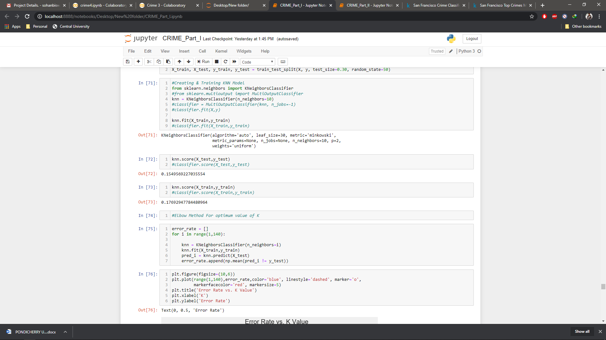
1. KNN (K- Nearest neighbors)
KNN can be used for both classification and regression predictive problems.
The 3 important aspects:
1. Ease to interpret output
2. Calculation time
3. Predictive Power
KNN Score for (X_test, y_test) was:
0.1549569227035554
KNN Score for(X_train, y_train) was:
0.17692947784480964

Slide 18
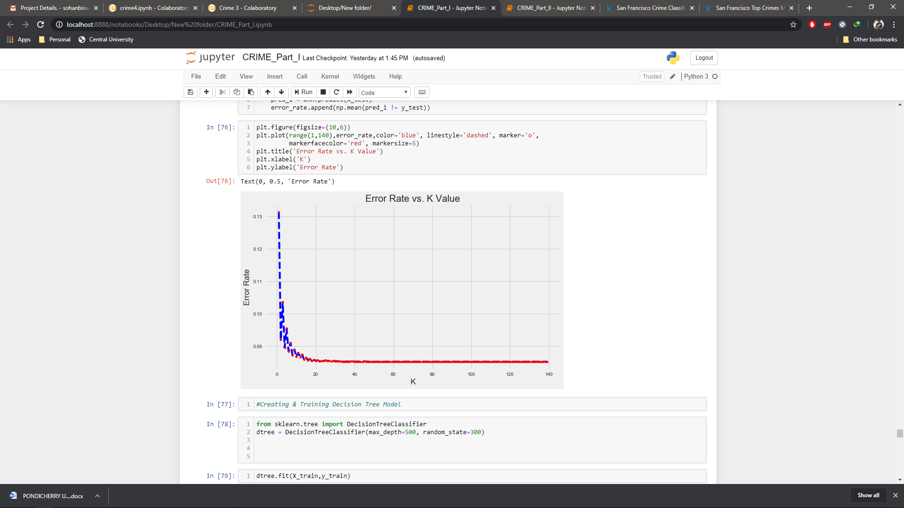
Error rate vs K value:
k-NN algorithm is the that the number of features and the number of classes both don't play a part in determining the value of k. It indicates the number of training samples that are needed to classify the test sample.
The k nearest neighbor (KNN) algorithm is affected by several factors such as:
1. Dimensionality of the data points
2. The size of K
3. Data distribution

Slide 19
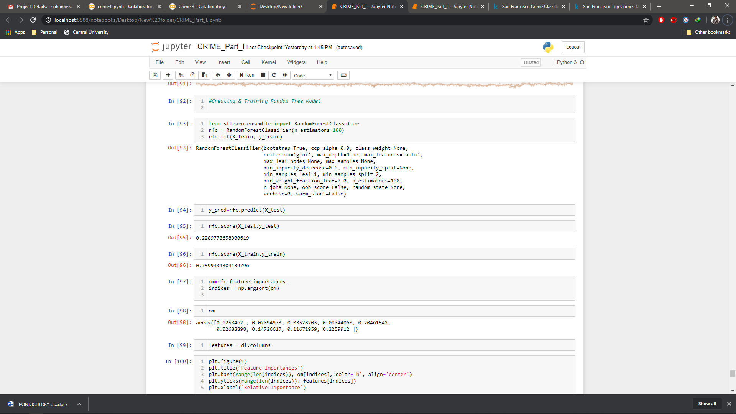
2. Random Forests
A random forest is a meta estimator that fits a number of decision tree classifiers on various sub-samples of the dataset and uses averaging to improve the predictive accuracy and control over-fitting.
RFC Score for (X_test, y_test) was:
0.2289770658900619
RFC Score for(X_train, y_train) was:
0.7599334304139796

Slide 20
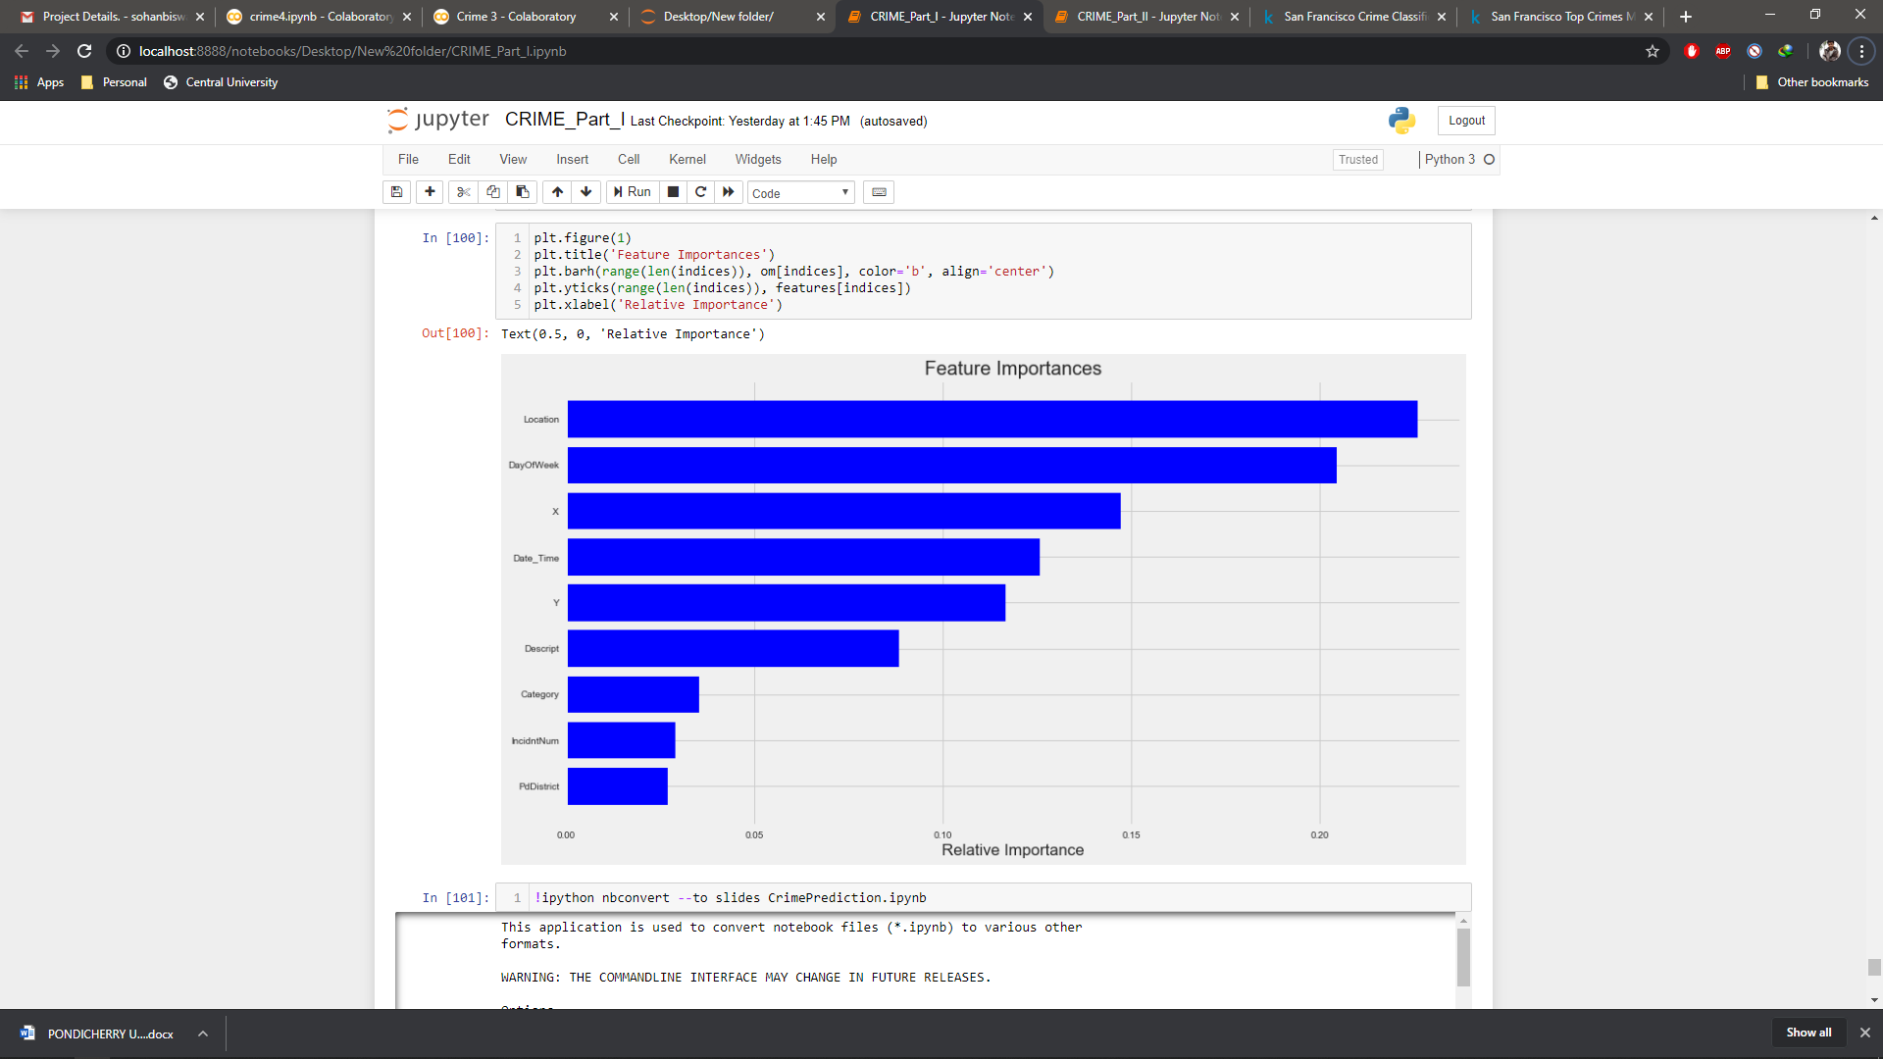
Important features vs Relative features:

Slide 21
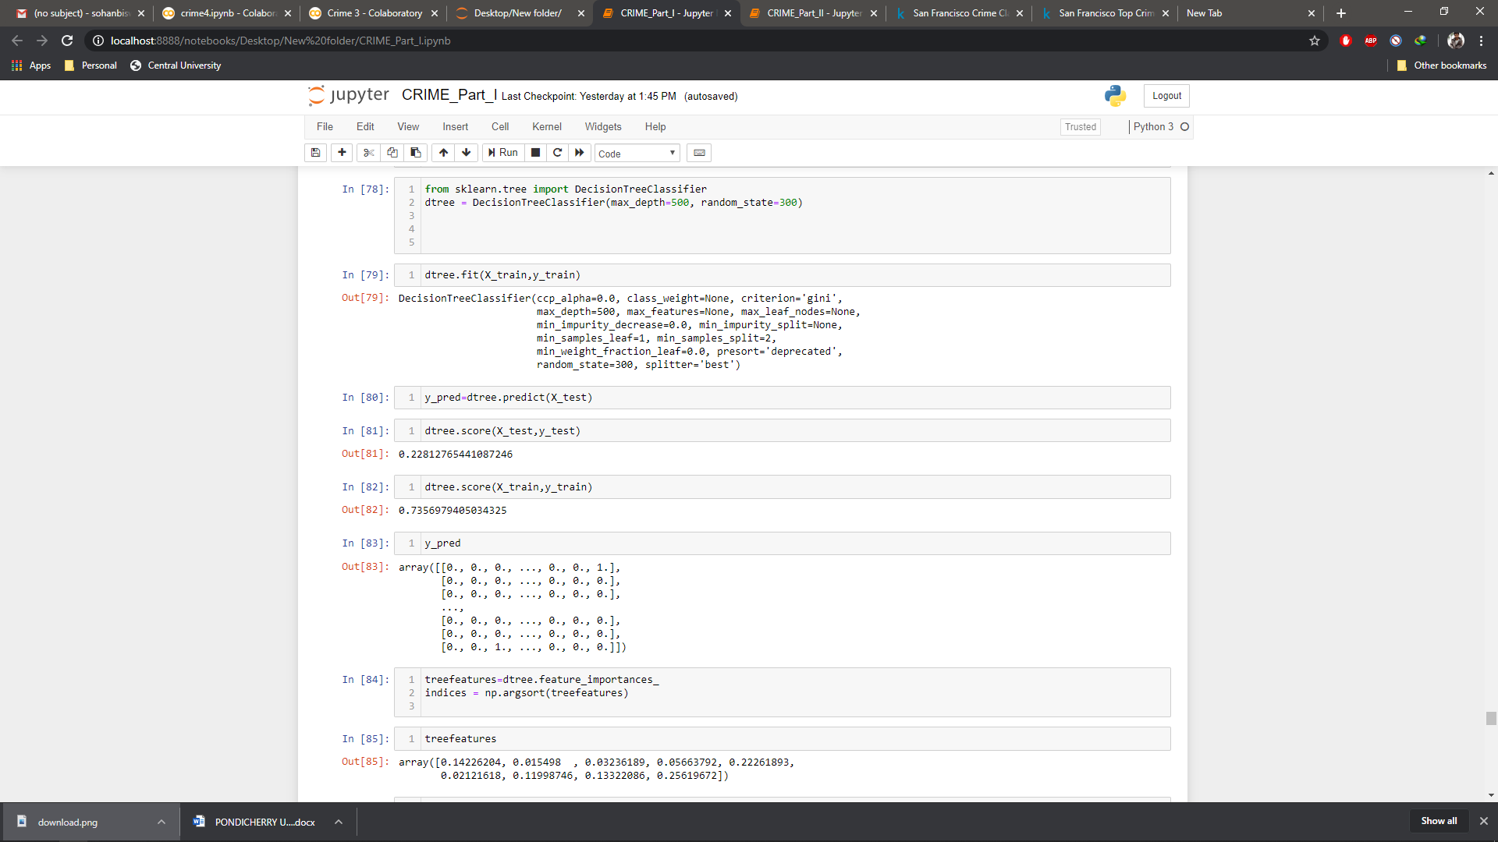
3. Decision Tree
A decision tree is a flowchart-like structure in which each internal node represents a “test” on an attribute (e.g. whether a coin flip comes up heads or tails), each branch represents the outcome of the test, and each leaf node represents a class label (decision taken after computing all attributes).
DTree Score for (X_test, y_test) was:
0.22812765441087246
DTree Score for(X_train, y_train) was:
0.7356979405034325
Y_predict:

Slide 22
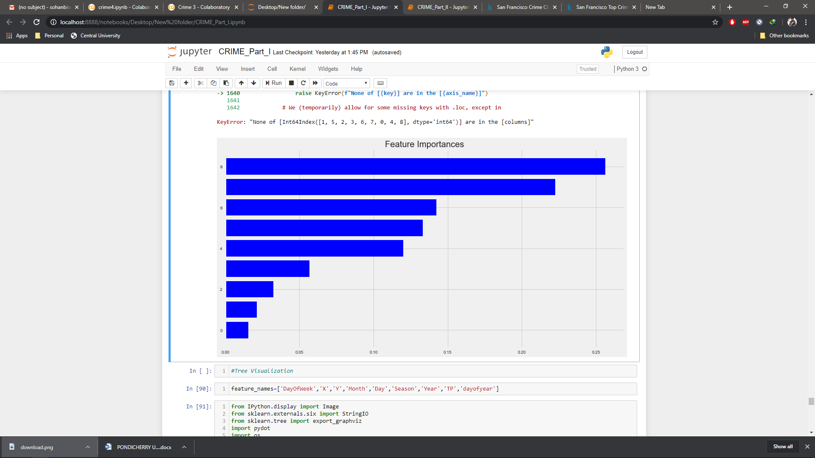
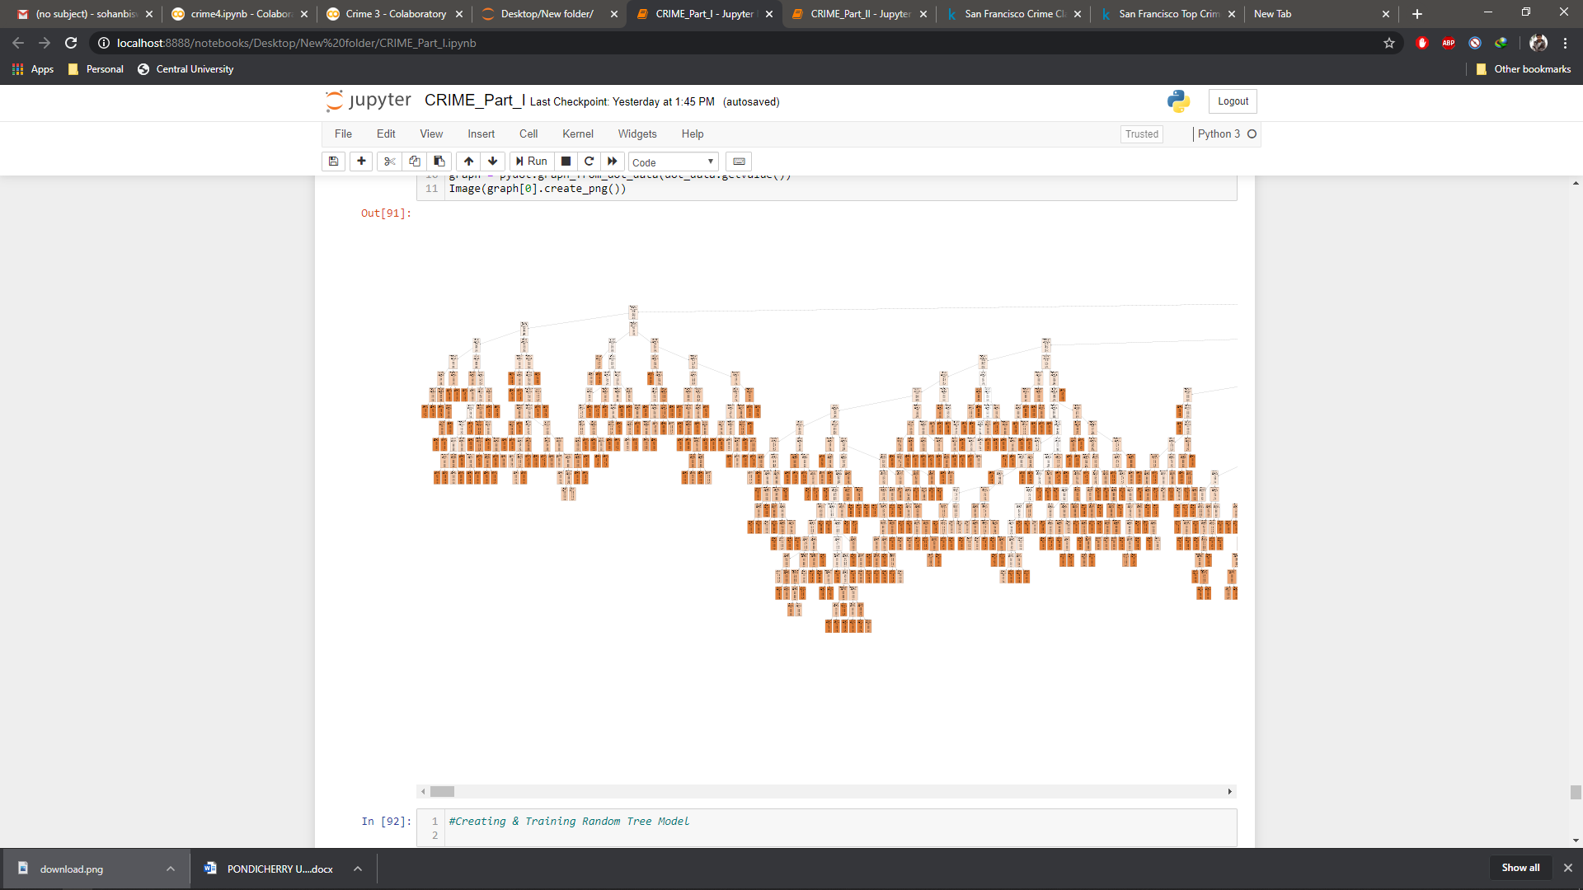
Important features vs Relative features: Tree Visualization*:
*This visualization is too long, so I have just presented a part of that here, the original is appended in the main file for the project.

Slide 23
4. LSTM
Here I have tried the LSTM method for some very specific reasons:
1. This dataset was a multivariate one, hence Multi-Variate LSTM with
supervised input was implemented.
2. The dataset was too large for ARIMA to be performed, since ARIMA can
only be used in dataset that has less values to begin with.
3. The dataset was organized in a way that the ‘t’ , ‘t+1’ up to ‘t+24’ hours can
be fitted for better accuracy.

Slide 24
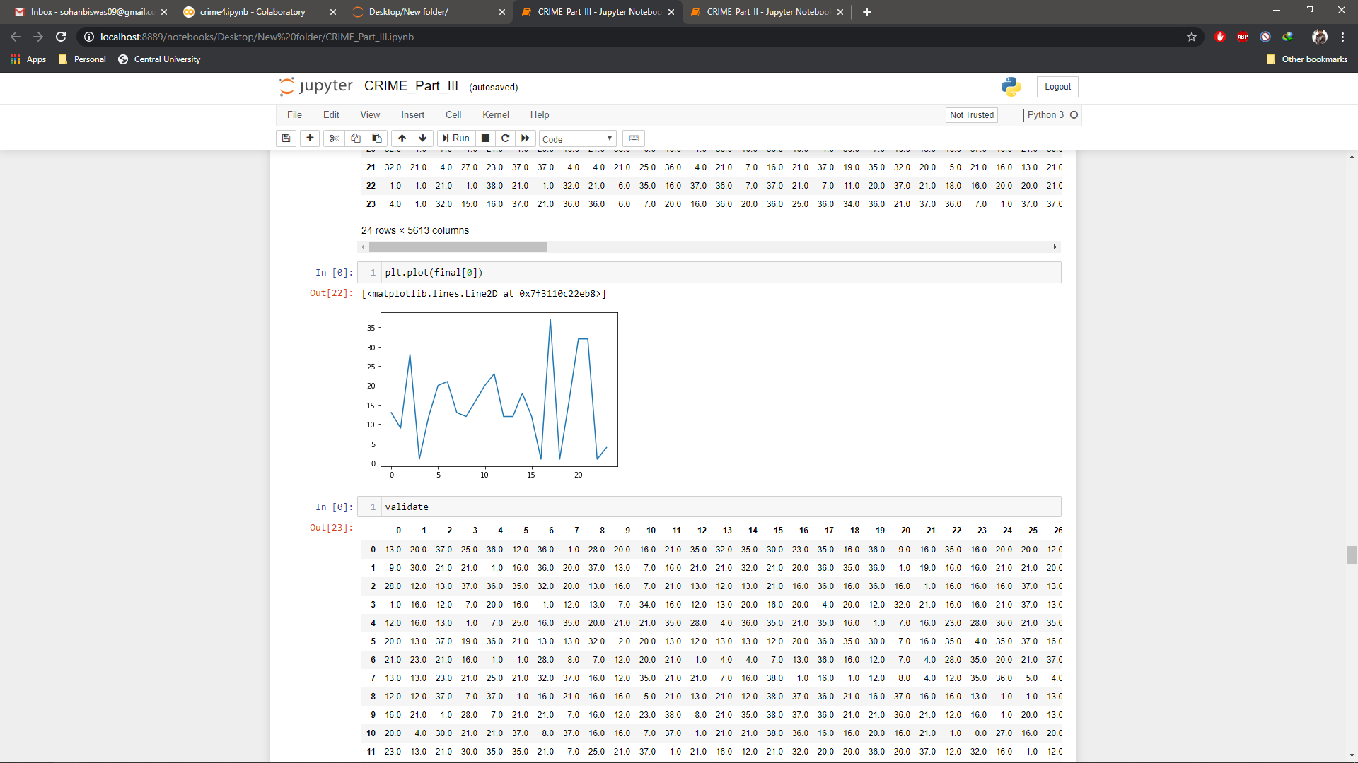
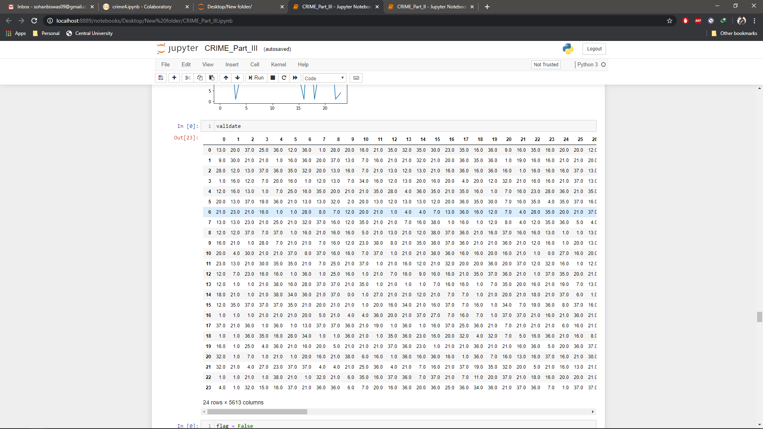
This figure plots the different crime categories over time arranged in ‘t+24’ format

Slide 25
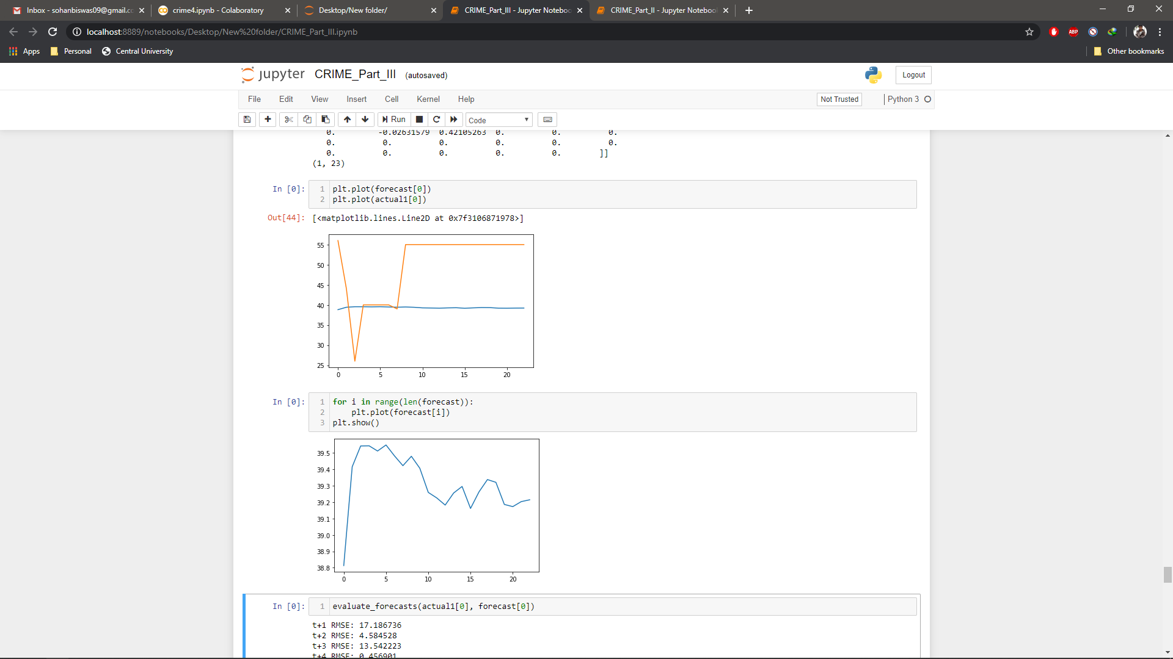
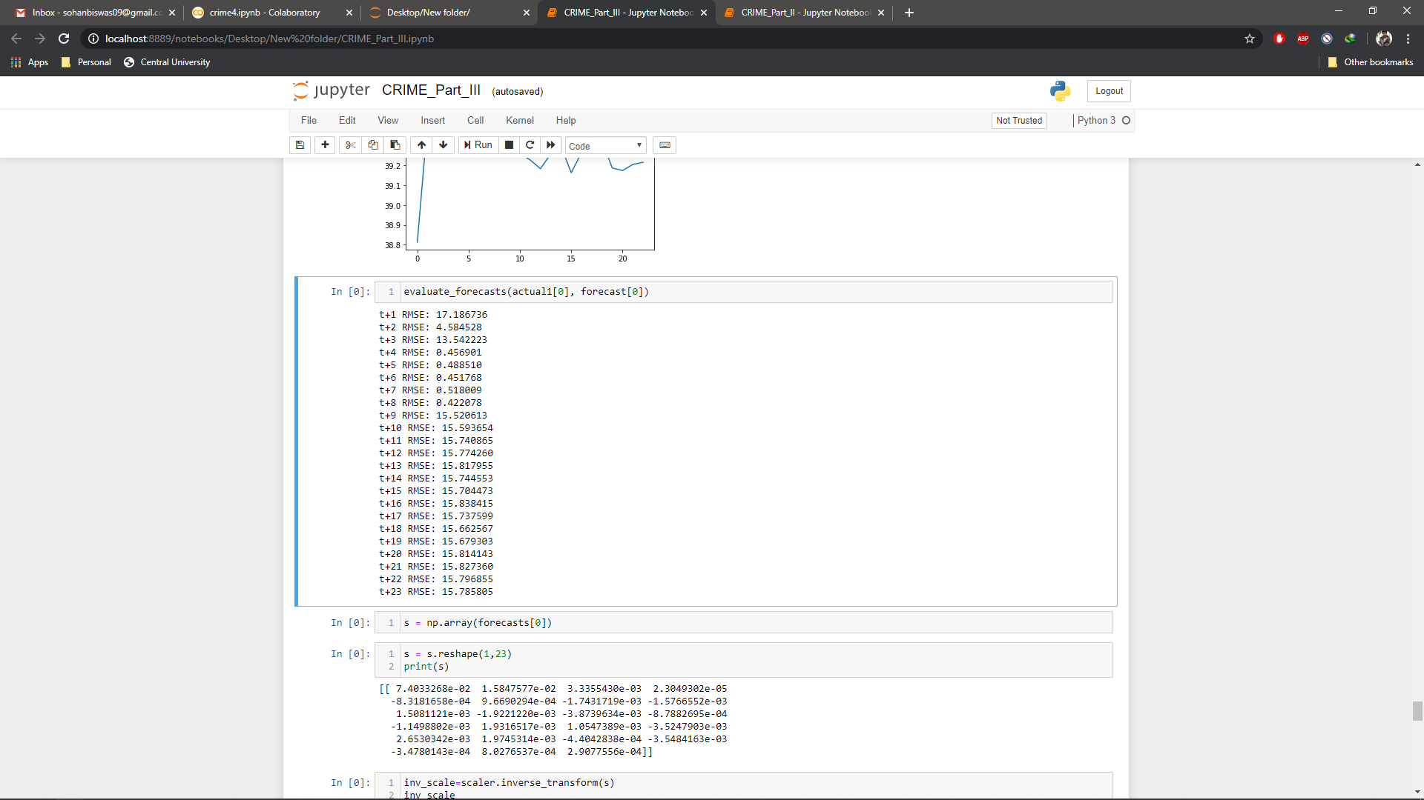
These figure plots are:
The forecast vs actual plot: The different crime categories forecasted over time arranged in ‘t+24’ format:

Slide 26
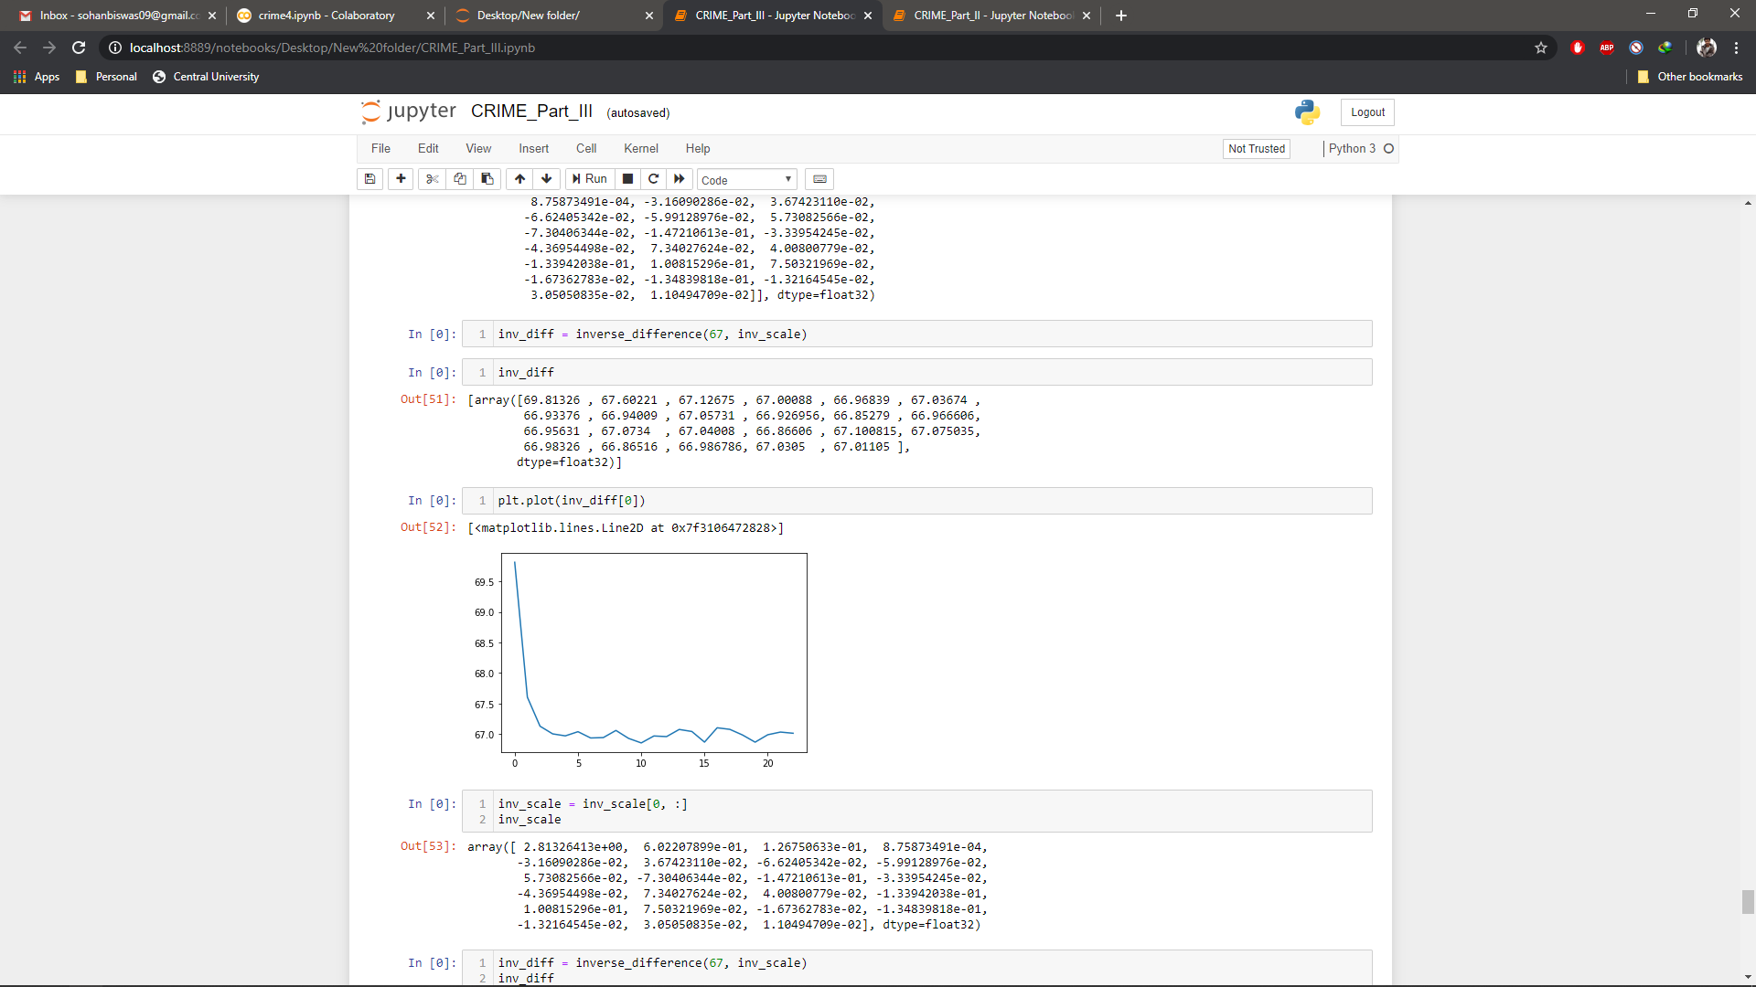
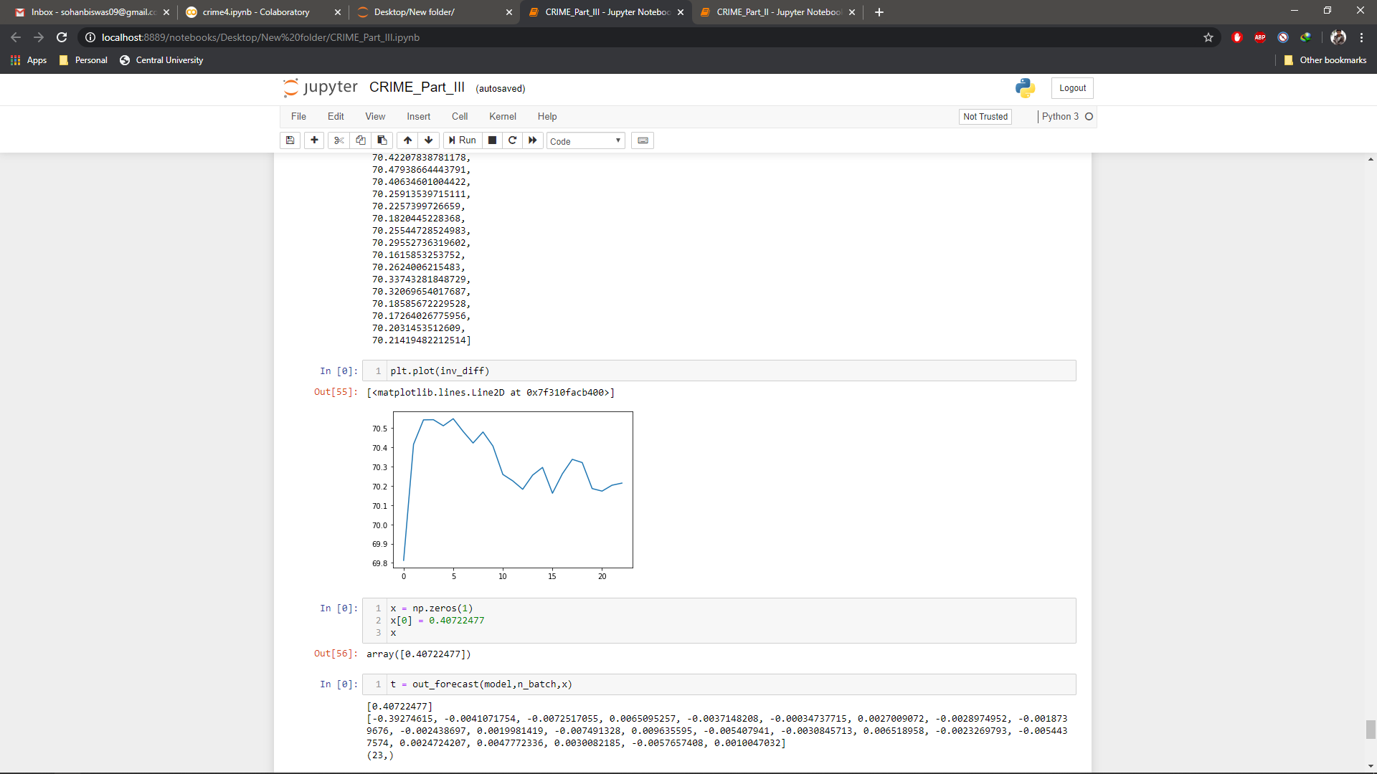
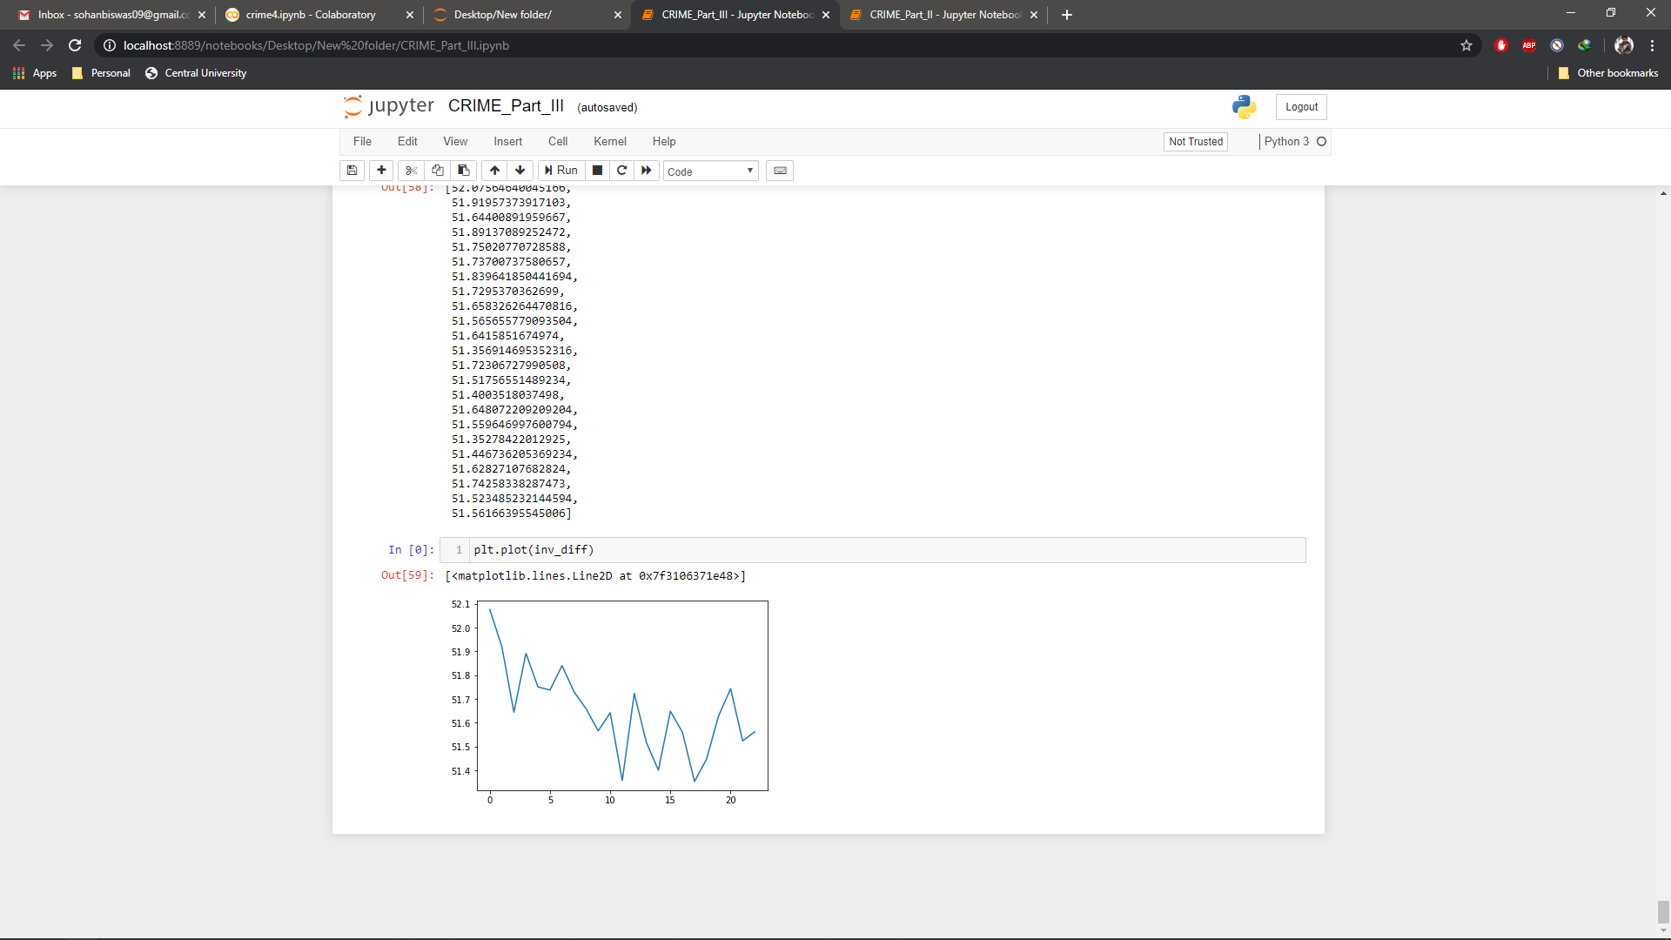
Predictive plotting of the various inverse difference after LSTM:
After reshaping After inverse scaling After out_forcast and transform

Slide 27
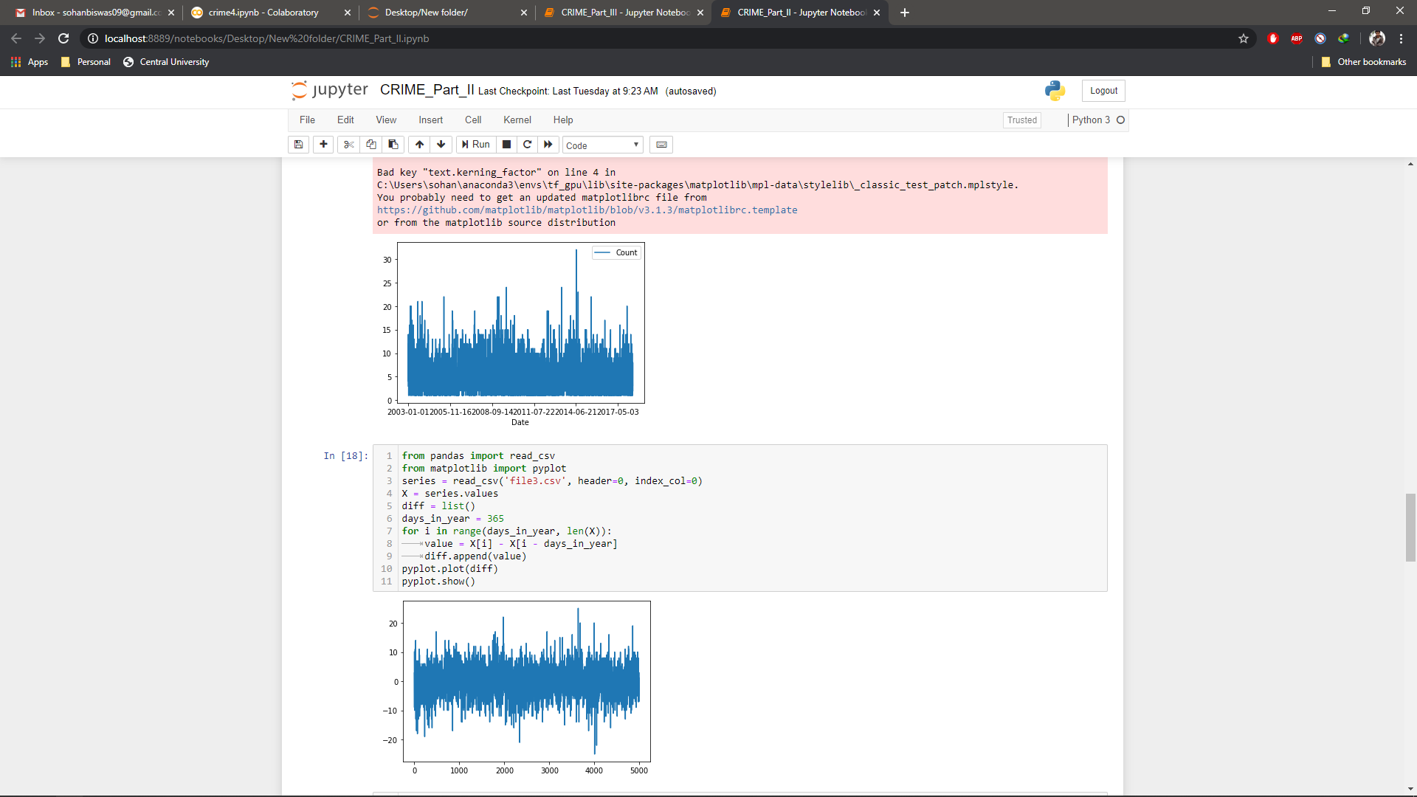
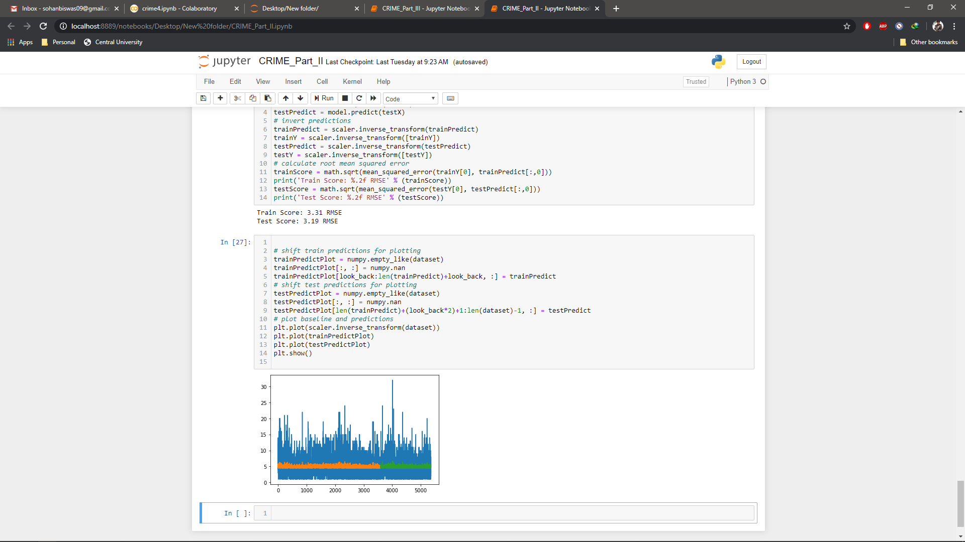
Prediction based on dates:
Before Prediction: Count vs Dates and Their value = X[i] - X[i - days_in_year]
After Prediction:
Train Score: 3.31 RMSE
Test Score: 3.19 RMSE
* Root Mean Square Error (RMSE) is the standard deviation of the residuals (prediction errors). Residuals are a measure of how far from the regression line data points are; RMSE is a measure of how spread out these residuals are. In other words, it tells you how concentrated the data is around the line of best fit.

Slide 28
4. Prophet by facebook
Prophet is a procedure for forecasting time series data based on an additive model where non-linear trends are fit with yearly, weekly, and daily seasonality, plus holiday effects.
Predictions are made on a dataframe with a column “ds” and “y”.

Slide 29
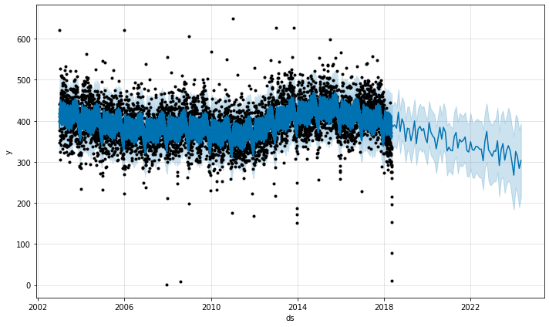
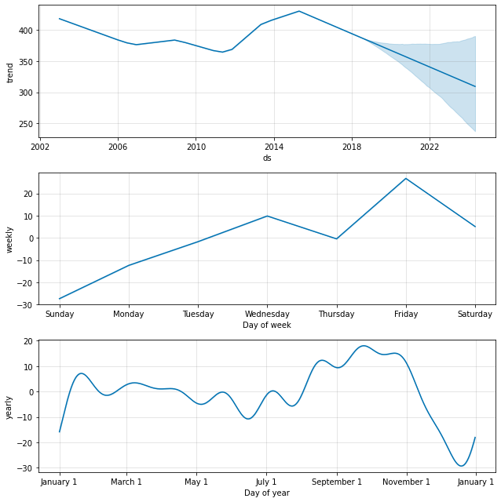
Initial predictions The trends for the dataset

Slide 30
After this a series of predictive outputs were given that helps change and better shape the output for the prediction with each change points. If any problems occur, the algorithms shift directly to Newtons rule and that makes it that much robust in implementation and use.
There were total 25 change points that were encountered, and the prediction changed accordingly, a simple comparison between the 1st and the 25th will be very clear.

Slide 31
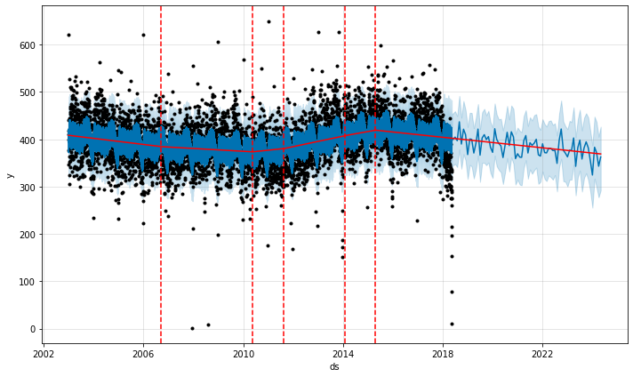
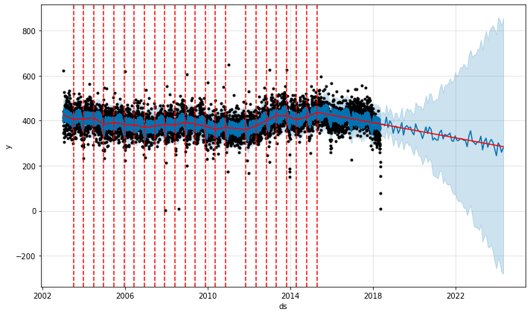
1st Prediction vs 25th Prediction

Slide 32
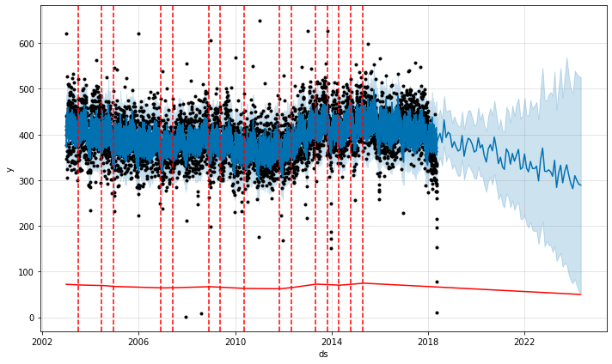
This algorithm takes into consideration of facts that may play crucial roles in seasonality; including holidays etc. and does the couple year’s forecasting .

Slide 33
Plotting them on map as hot keys:
This part of plotting them on map using folium is done.
Here in using folium I have plotted the initial plotting of the crime that had already taken place based on neighborhood.
Next, I have forecasted the immediate next month prediction of the crime hotspots that may or may not be the possible predicted value for the crime.
I have done this using Facebook Prophet, by tweaking it a little bit.

Slide 34
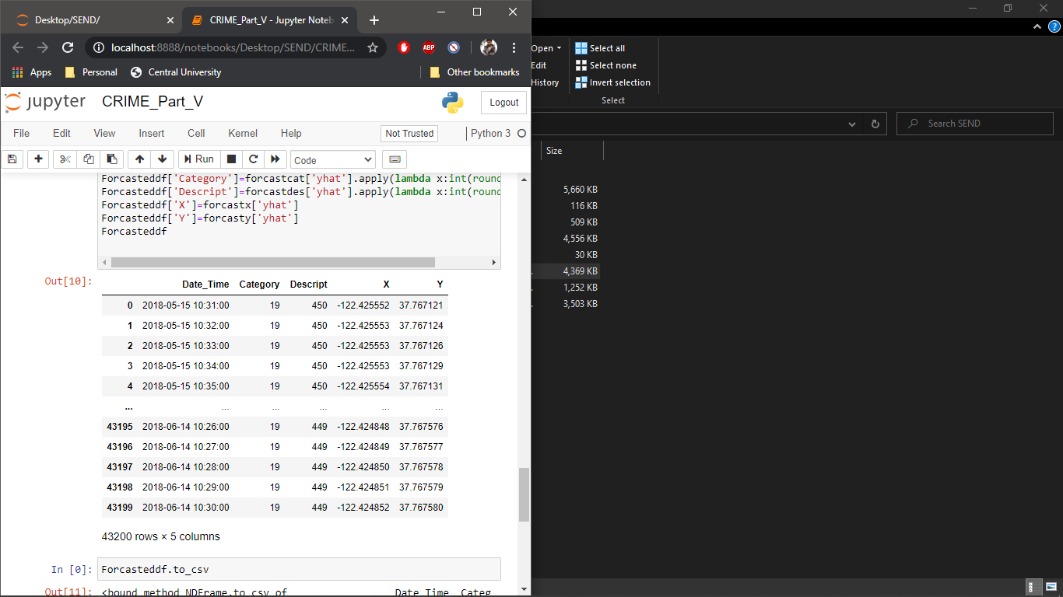
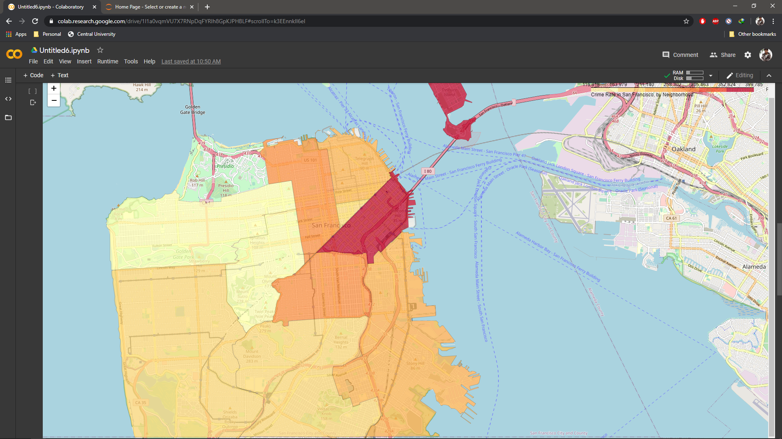
Here I have basically set the forecasted range as per minute parameter for
the immediate next month of the dataset and saved it. The function used here:
prfcat.make_future_dataframe
(30*24*60,'min',False) Heatmaps vs count.
before prediction,
as heatmaps vs count.

Slide 35
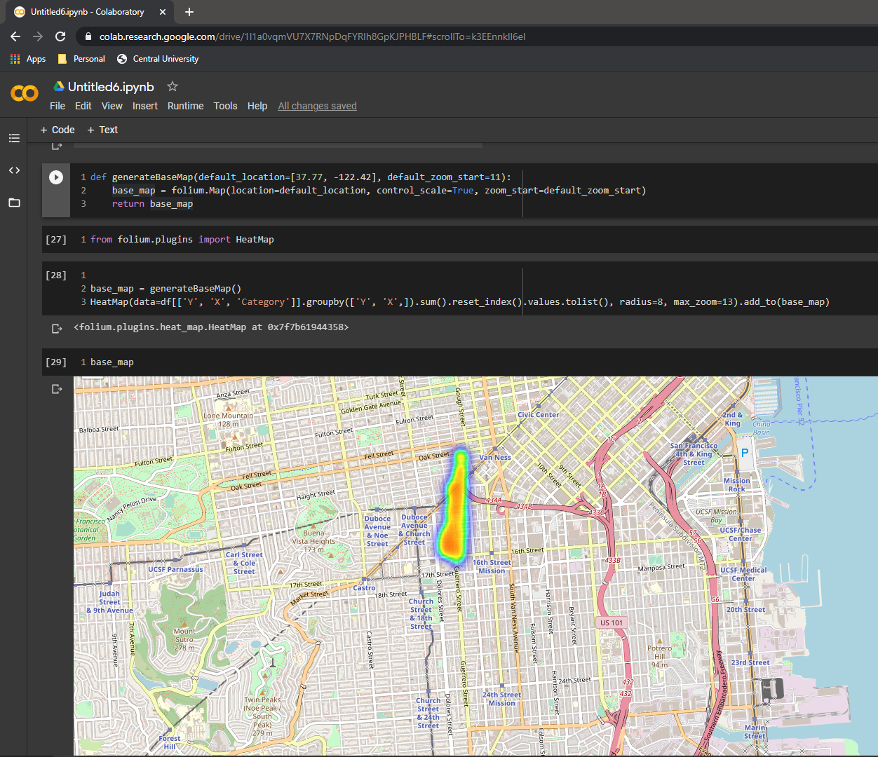
After prediction
This prediction is for only 1 month
since the dataset ended.
Period:
5/15/2018 10:31:00 AM to
6/14/2018 10:30:00 AM
There are also various spots in the map
but since this one was clustered too much,
It was shown.

Slide 36
Important codes and such are added in the main report, and sent as a whole .ipynb files named:
CRIME_Part_I .ipynb
CRIME_Part_II .ipynb
CRIME_Part_III .ipynb
CRIME_Part_IV .ipynb
CRIME_Part_V .ipynb
CRIME_Part _VI.ipynb

Slide 37
Thank You.

